Slide 1
Standing on the shoulders of giants Being a good open source citizen
John Patterson • 6th September 2016

Slide 2

Transformation
Transformation

Slide 3
Transformation
Waterfall ➾ Agile
Notes:
Waterfall we approach software in stages
Analysis, design, implement, test, deliver, maintain
At each stage we have documentation, handovers and un needed processes
Waterfall approach is not very collaborative, the customer tells the BA, the BA tells the Functional Analyst, the functional analyst talks to the developers and testers, no body talks to Basis and support.
Very long cycle time, often months or years from idea to software, big bang or BDUF
An agile or a lean approach is quite opposite, reduce the waste, by removng unneeded documentation, processes handovers, break big software development into small batch sizes, collaborate with users and testers early and often, bake quality in by removing un needed features, prioiritize features that are needed, incrementally build, a much faster time to business value, build, measure, learn, learn to fail fast.

Slide 4
Transformation
Data Centre ➾ Cloud
Notes:
Moving from data center to cloud is really a transition away from the traditional IT constraints
Moving to the cloud means you don’t have the overhead of owning and running hardware (Capex and Opex), which means savings can be reinvested in to delivering business value.
The advantage of moving to the cloud for businesses, is that they can adapt to market changes quicker and take more risks.

Slide 5
Transformation
Sys Admin ➾ DevOps
Notes:
DevOps is not a tool or a job description, fundamentally it is a cultural change.
The heart of devOps is the idea of collaboration, removing silos and teams that work in silos, work together with the goal is to deliver business value quicker.
DevOps introduces concepts like Continuous Integration and Continuous Delivery, the idea is that software continuously evolves and does so frequently, to cater for these changes we need to automate as much of process as possible, think about RAB and CAB meetings, to break down the cycle time to production from months to days to hours, really need to eliminate waste and stopping thinking about the risk of doing something and start thinking about the risk of not doing it.
There are many good examples of DevOp culture amongst the startups that are disrupting. Companies like Etsy believe that new recruits should be deploying value to production on their first day of work, can be a bug fix, configuration whatever, the idea is get them into the habit of devlivering. Companies like Netflix and Amazon deploy 10,000 of thousands of changes to production a day and believe if you build it you should deploy, the idea is that if you are autonomous and responsible, you are more likely to not make mistakes are trying and deploy shitty code

Slide 6
https://www.flickr.com/photos/lucaserazzi/
Transformation
Closed ➾ Open Source

Slide 7
Why did SAP bet big on Open Source?
An aging proprietary code base

Slide 8
Why did SAP bet big on Open Source?
Customers technology needs are changing

Slide 9
Why did SAP bet big on Open Source?
Competitors are innovating

Slide 10
Why did SAP bet big on Open Source?
Investors have many options

Slide 11
Why did SAP bet big on Open Source?
For a cultural change

Slide 12
SAP bet big on Open Source because
They needed to create a platform for innovation

Slide 13
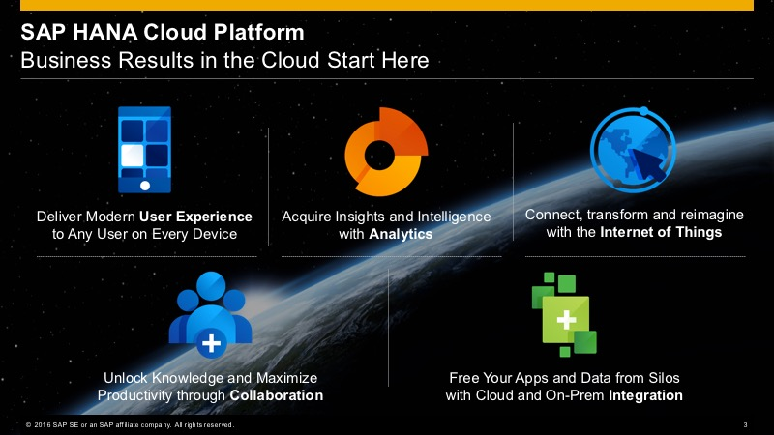
The road ahead with SAP HANA Cloud Platform and Cloud Foundry
built using Open Source and Open Standards
Notes:
Internal and external pressure
Need a platform for innovation
Culture that needs to embrace change
The whole platform is using open source and open standards quite extensively and allows a quick on-boarding of developers. The developers can re-use their know how in best-of-breed software and can concentrate on creating value-adding services and applications instead of learning proprietary technologies.

Slide 14
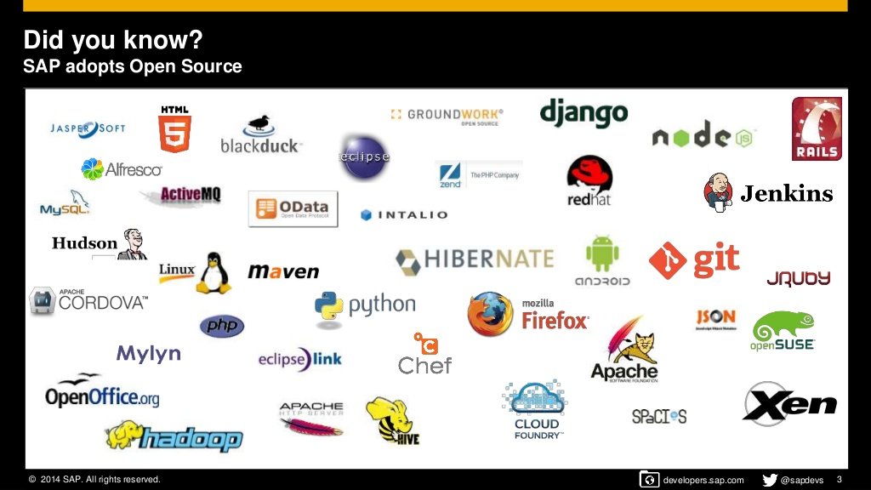
Win win sap and open source in the enterprise
Notes:
WIN WIN

Slide 15
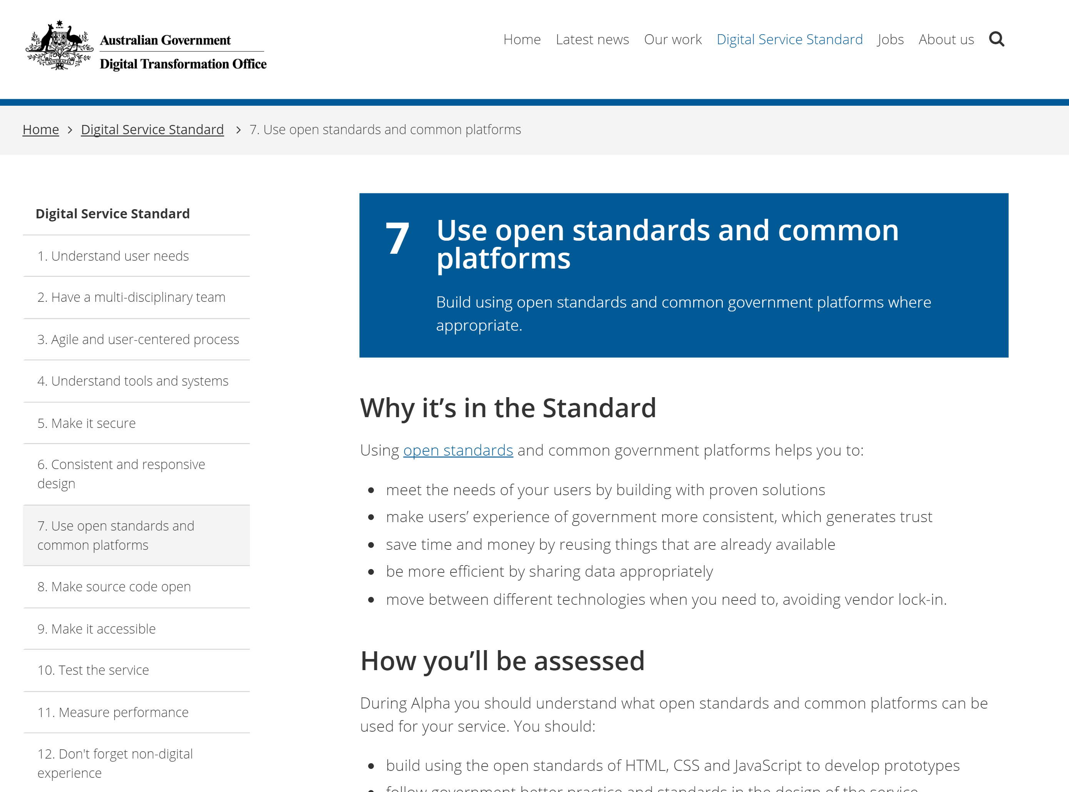
https://www.dto.gov.au/standard/7-open-standards-and-common-platforms/

Slide 16
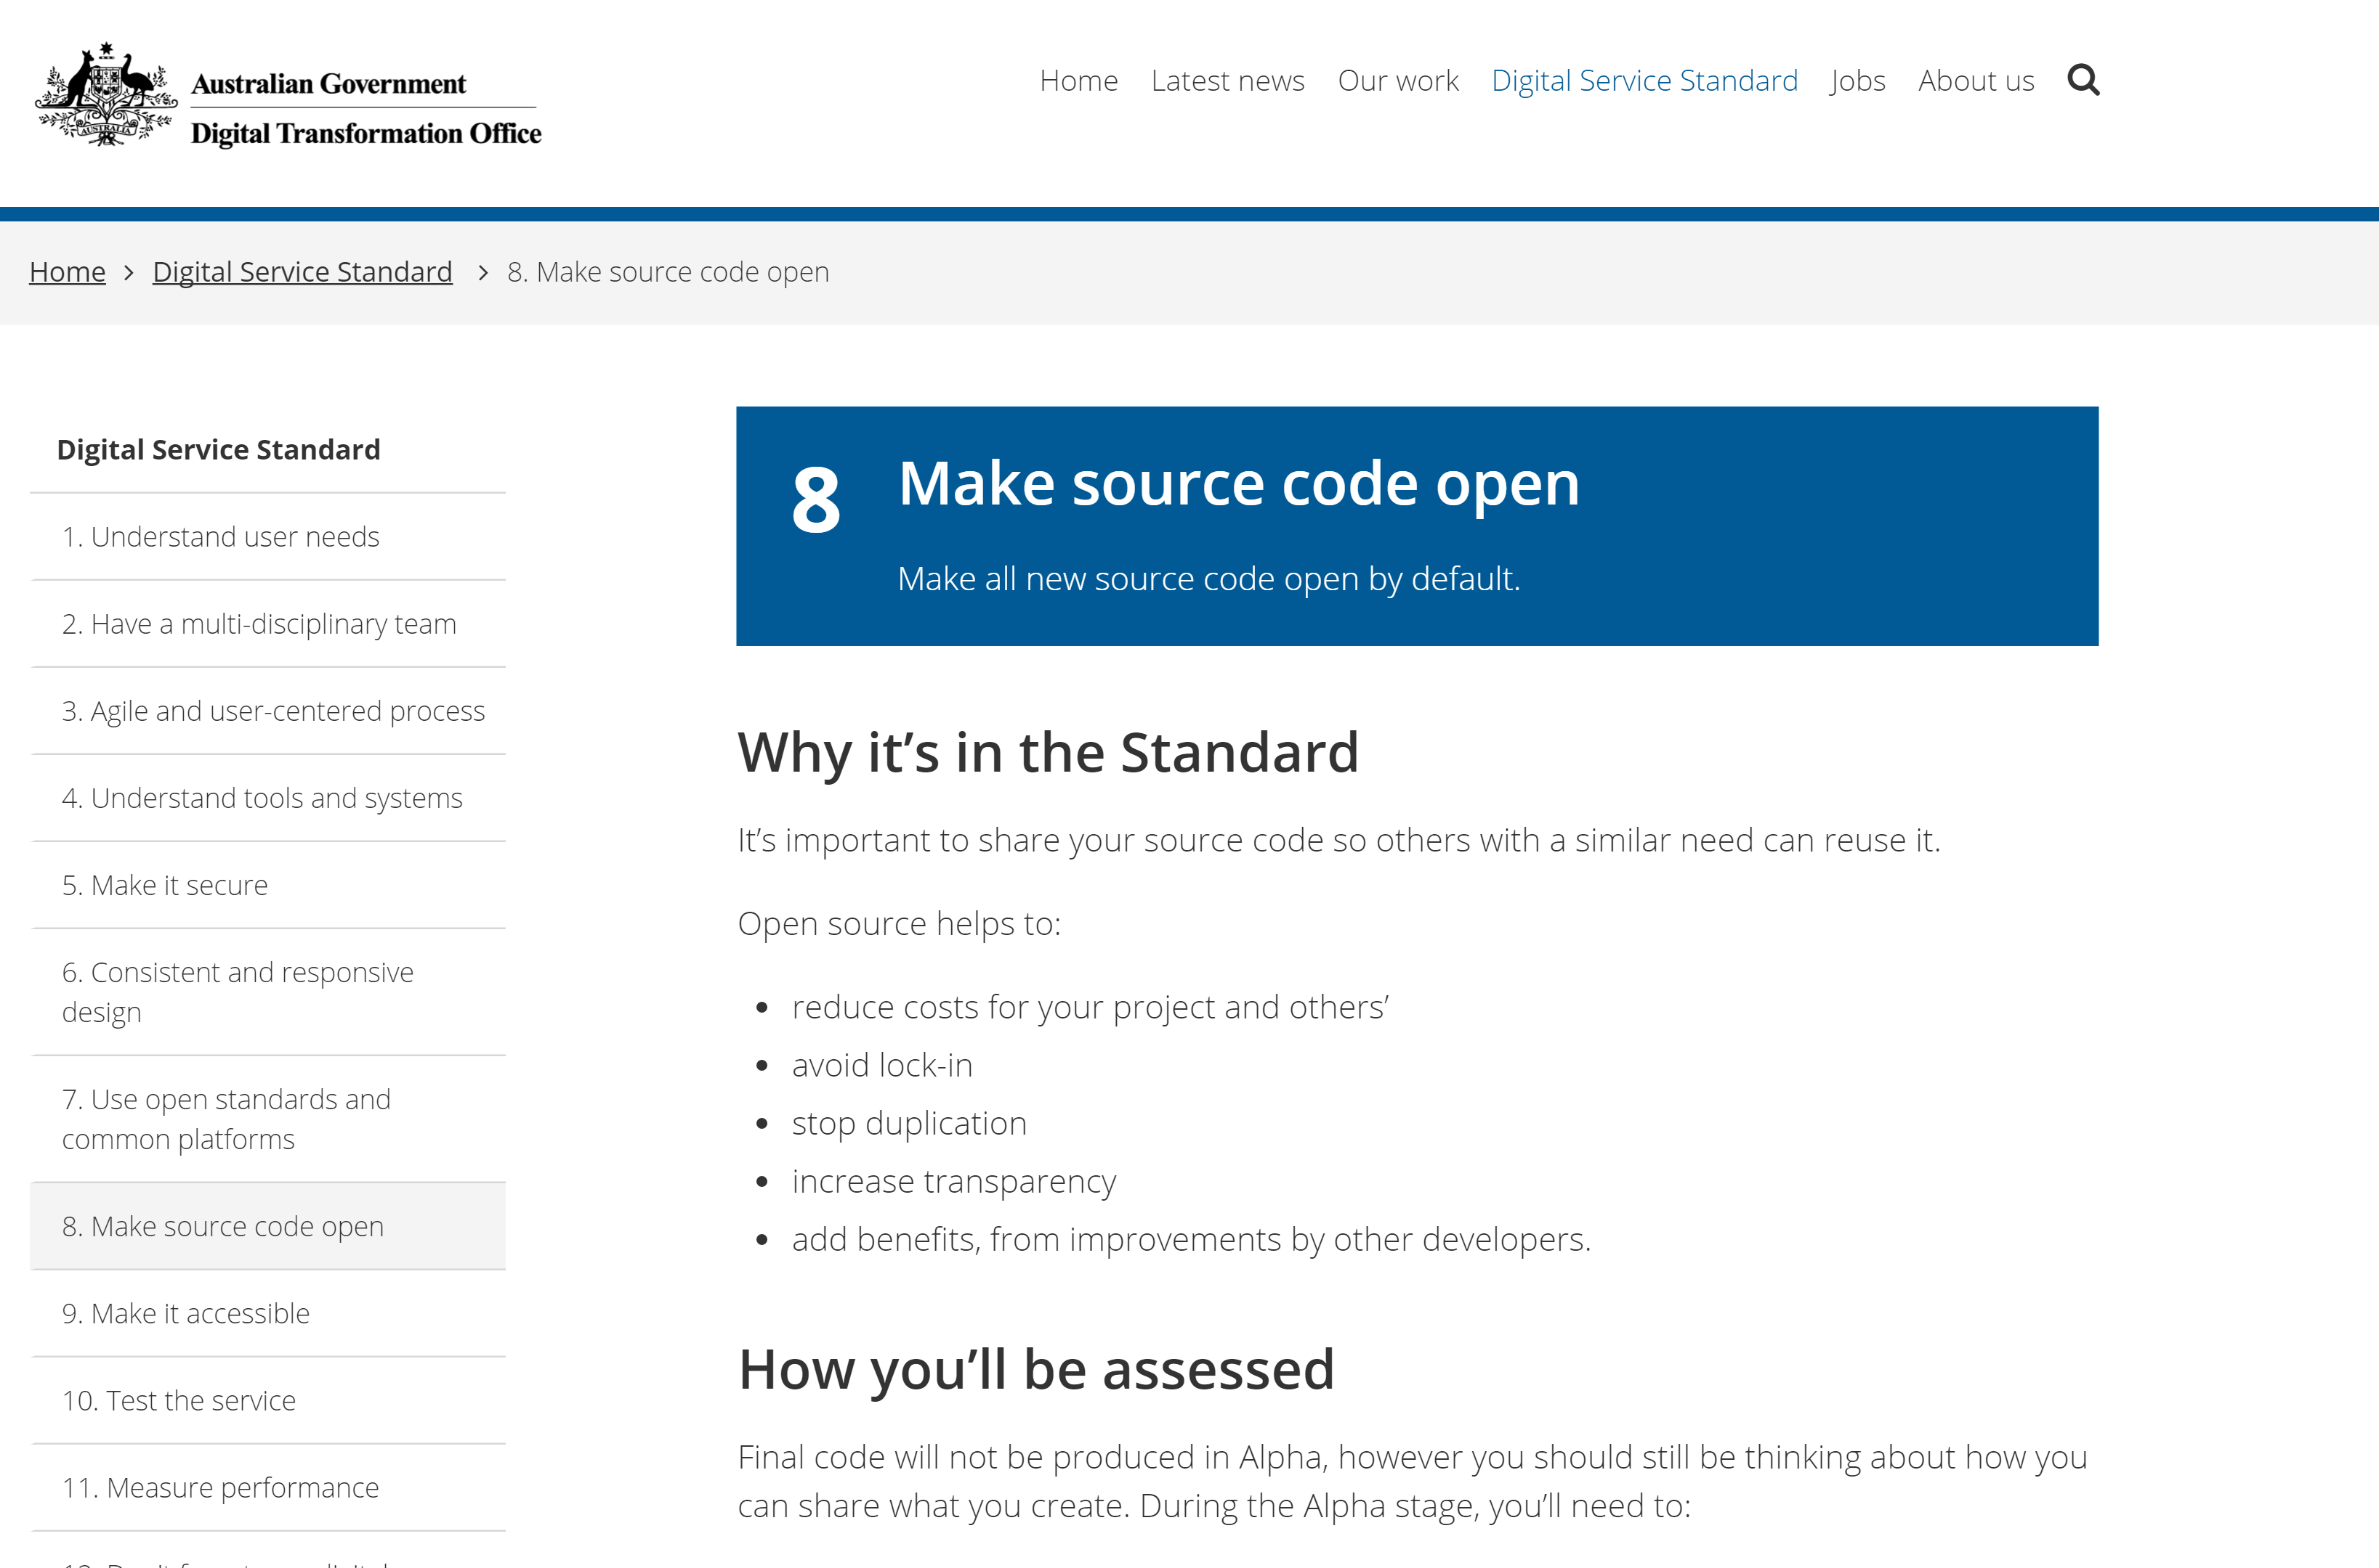
https://www.dto.gov.au/standard/8-make-source-code-open/

Slide 17

https://www.flickr.com/photos/naudinsylvain/
Not Gratis

Slide 18

Free as in beer

Slide 19
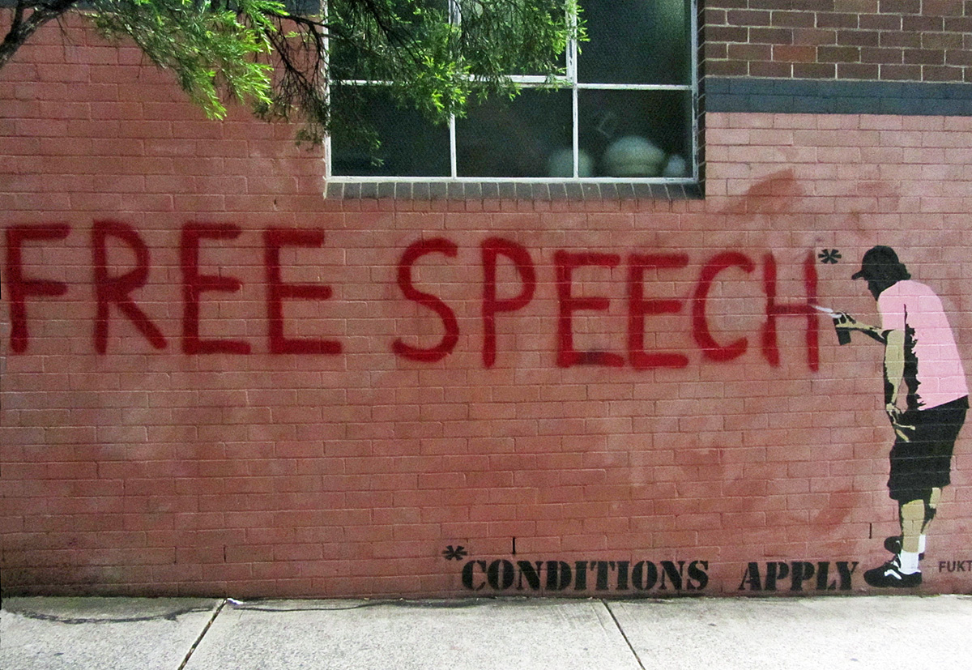
Free to run
Free to run

Slide 20
Free to study
Free to run

Slide 21
Free to redistribute
Free to run

Slide 22
Free to improve
Free to run
Newtown grafitti

Slide 23
P
Quality Code
“Given enough eyeballs, all bugs are shallow.”
-- Linus Torvalds --

Slide 24
Shared code is copyrighted until it is licensed
Notes:
CopyLeft, kind of the opposite of CopyRight also referred to as a viral license, is an arrangement whereby software may be used, modified, and distributed freely on condition that anything derived from it is bound by the same conditions of rights. That is the work I build on top of this code, has to be published and can be used freely by others also – no IP, example General Public Licenses GNU and Lesser GPL
Downstream licenses like Eclipse and Microsoft Public licenses are less restrictive and you don’t have to published
Attribution licenses are quite liberal and means you can use, however you need to attribute the author of the original work

Slide 25
License spectrum
Restrictive
ATTRIBUTION
BSD
MIT
Apache
DOWNSTREAM
MPL
EPL
MS-RL
COPYLEFT
GPL
LGPL
AGPL
Best Practices for Using Open Source Software in the Enterprise
Permissive
Notes:
CopyLeft, kind of the opposite of CopyRight also referred to as a viral license, is an arrangement whereby software may be used, modified, and distributed freely on condition that anything derived from it is bound by the same conditions of rights. That is the work I build on top of this code, has to be published and can be used freely by others also – no IP, example General Public Licenses GNU and Lesser GPL
Downstream licenses like Eclipse and Microsoft Public licenses are less restrictive and you don’t have to published
Attribution licenses are quite liberal and means you can use, however you need to attribute the author of the original work

Slide 26
P
Sharing Ideas
“If you have an apple and I have an apple and we exchange these apples then you and I will still each have one apple. But if you have an idea and I have an idea and we exchange these ideas, then each of us will have two ideas.”
-- George Bernard Shaw --

Slide 27
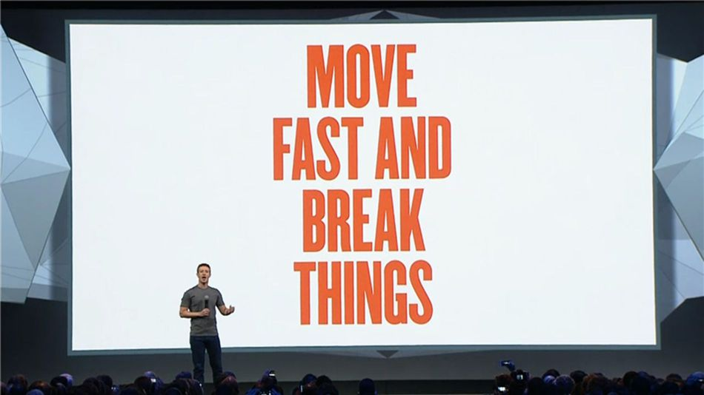
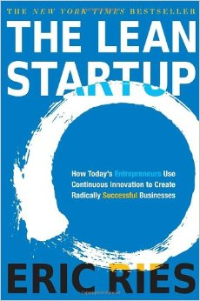
Image: Facebook

Slide 28
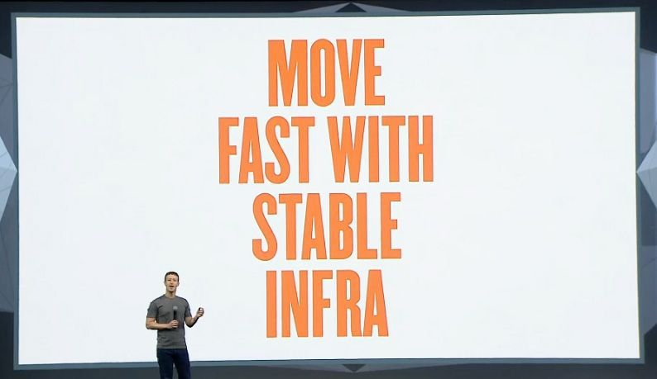
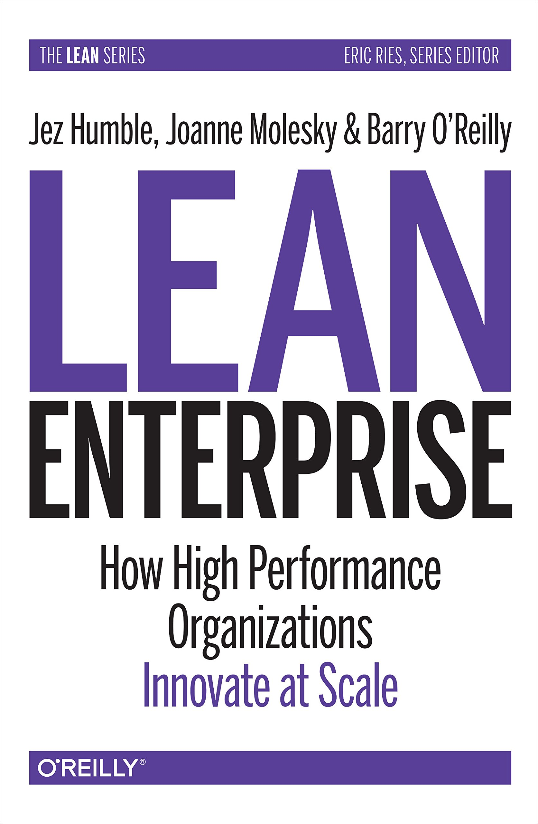
Image: Facebook

Slide 29
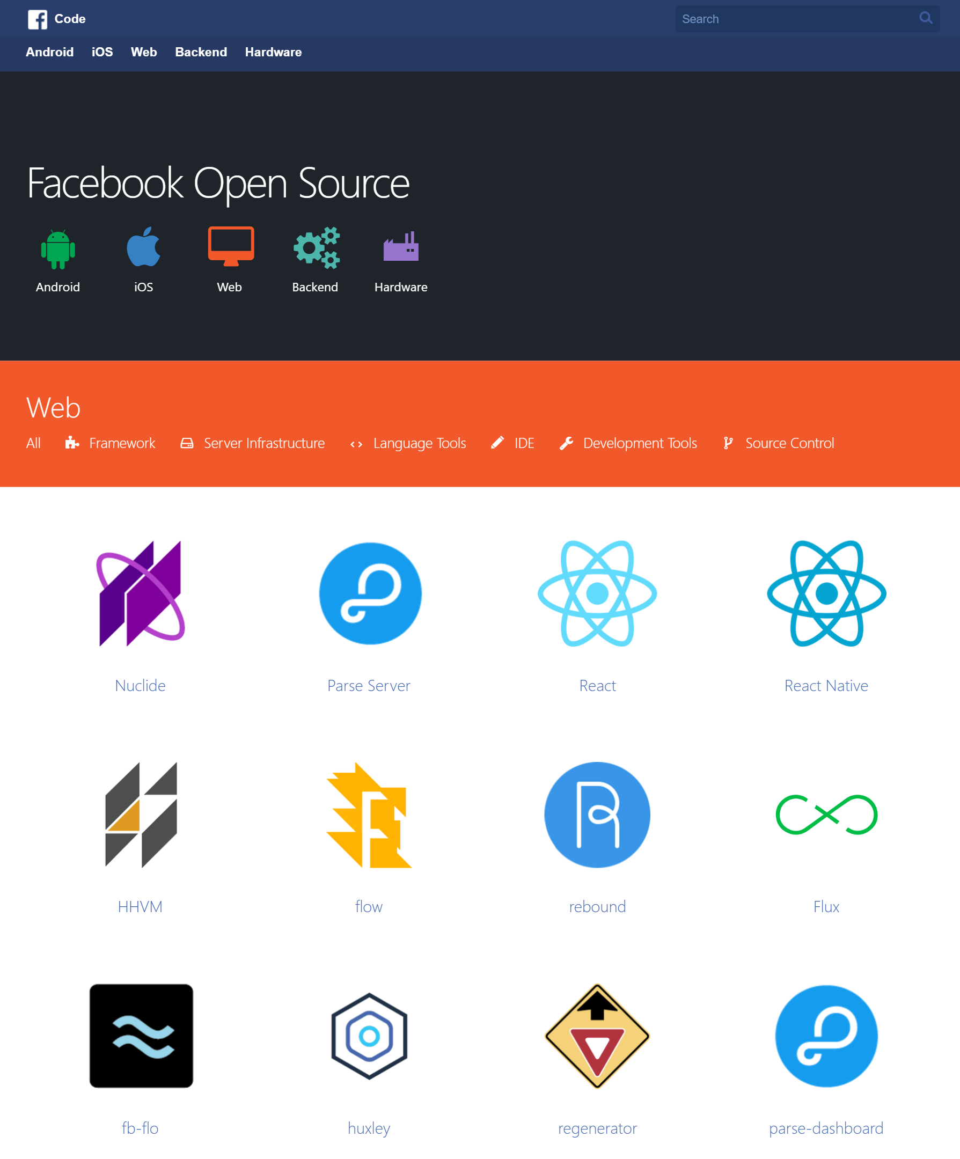
REASONS WHY
Notes:
274 open source projects
800+ internal developers
242,000 followers
1.5 billion users

Slide 30
P
“People don't buy what you do; they buy why you do it. And what you do simply proves what you believe”
-- Simon Sinek --

Slide 31
It’s in our DNA
1
“The Facebook” Day 0 Dorm Room, LAMP stack

Slide 32
It’s in our DNA
“standing on the shoulders of giants and give back in turn” James Pearce head of Open Source at Facebook,
1
“Standing on the shoulders of giants and give back in turn”
-- James Pearce head of Open Source --
Notes:
Hackerathons

Slide 33
Part of our mission
2
“To make the world more connected”
-- Mark Zuckerberg --

Slide 34
Accelerates Innovation
3
Sharing ideas to help the industry grow

Slide 35
We write better software
4
“The more the Open Source philosophy bleeds out through the engineering team, the better the systems”
-- James Pearce head of Open Source --
Notes:
Modular, well maintained,

Slide 36
An opportunity to share our challenges
5
Attracts the interest of people who want to work on them
Notes:
Recruiting angle works, the fact that developers have already used the software means that the new recruits can ship code with in days or hours

Slide 37
Becoming a good citizen

Slide 38
Benefits of contributing to open source
A sense of giving back to the community

Slide 39
Benefits of contributing to open source
Become a better developer

Slide 40
Benefits of contributing to open source
Improve your CV / Portfolio

Slide 41
Benefits of contributing to open source
Make yourself known

Slide 42
Benefits of contributing to open source
Be an authority and make money

Slide 43
OSS Contribution Funnel
Use
Be able to understand what it does
Can easily pick it up and use
Download
Fork / Follow / Favorite
Contribute Time
Log bugs
Answer questions
Write blog posts
Fix / add documentation
Fix typos
Best Practices for Using Open Source Software in the Enterprise
Contribute Code
Actually contribute code patches that fix bugs / improve test cases
Contribute entirely new features
Translate
Maintain platforms
Own
Become a core committer (get write access)
Accept / validate code contributions
Nurture new people
Stick around
Influence the direction of the project

Slide 44
Questions to ask before consuming?
10

Slide 45
What are people saying about it?
1
Read the reviews, blogs, tech journals, determine the reputation

Slide 46
Does it have a currently active community?
2
Are questions being asked + answered on StackOverflow, is there a Slack channel or a mailing list?

Slide 47
Do you have the skillset to maintain?
3
Before the contractor leaves ensure you have a training plan

Slide 48
Does it have good documentation?
4
Readme, Contribution Guidelines, Tutorials, Examples, Help + License

Slide 49
How frequently are versions being released?
5
Major versions, breaking versions, patches, is there a roadmap etc.

Slide 50
How many open issues?
6
The type of issues, how long and who is supporting?

Slide 51
Is quality baked in?
7
Look for a good testing story, programming guidelines, a formal review process, Continuous Integration etc.

Slide 52
Does it use open standards?
8
Ensure its not reinventing the wheel, interoperability with other software is key

Slide 53
How secure is the code?
9
Use audit software to catalog open source and third party dependencies and remedy vulnerabilities and violations found

Slide 54
Should we make time to give back?
10
A great way to attract new talent and upskill existing

Slide 55
Takeaways
1
Open source is as much a movement as it is a licensing approach
2
Open source and open standards are core to business software transformation and innovation
3
Do your due diligence before consuming code and have a plan for supporting it

Slide 56

Give something back to the community

